Slide 1
Operators and Cast

Slide 2
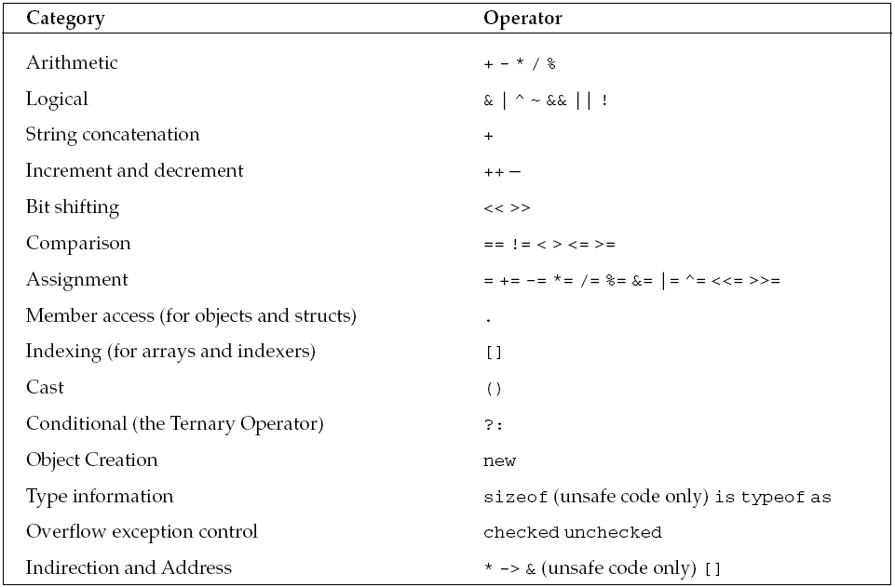
Operators

Slide 3
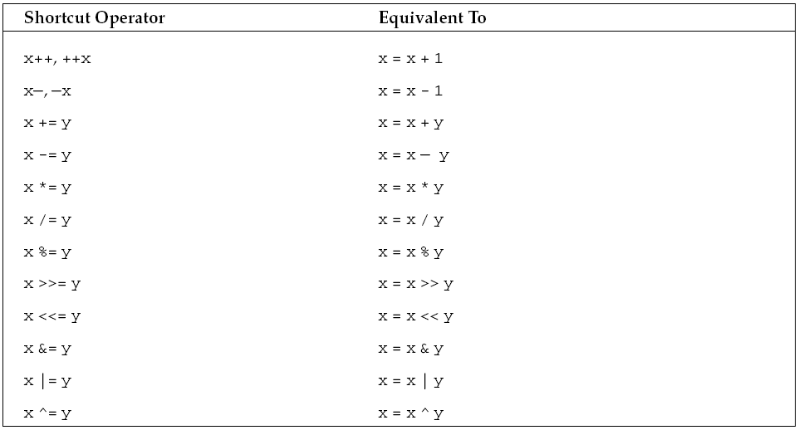
Operator Shortcuts

Slide 4
checked and unchecked Operators
byte b = 255;
b++;
Console.WriteLine(b.ToString());
The byte data type can only hold values in the range zero to 255, so incrementing the value of b causes an overflow.
To do this, C# provides the checked and unchecked operators.
If we mark a block of code as checked, the CLR will enforce overflow checking, and throw an exception if an overflow occurs.
Let’s change our code to include the checked operator:
byte b = 255;
checked
{ b++; }
Console.WriteLine(b.ToString());

Slide 5
If we want to suppress overflow checking, we can mark the code as unchecked:
byte b = 255;
unchecked
{ b++; }
Console.WriteLine(b.ToString());
b variable will hold a value of zero

Slide 6
The is Operator
The is operator allows us to check whether an object is compatible with a specific type.
For example, to check whether a variable is compatible with the object type:
By the phrase is compatible, we mean that an object is either of that type or is derived from that type.
int i = 10;
if (i is object)
{
Console.WriteLine(“i is an object”);
}
int, like all C# data types, inherits from object, therefore the expression i is object will evaluate to true, and the message will be displayed.

Slide 7
The as Operator
The as operator is used to perform explicit type conversions of reference types.
If the type being converted is compatible with the specified type, conversion is performed successfully.
However, if the types are incompatible, then the as operator returns the value null.
As shown in the following code, attempting to convert an object reference to a string will return null if the object reference does not actually refer to a string instance:
object o1 = “Some String”;
object o2 = 5;
string s1 = o1 as string; // s1 = “Some String”
string s2 = o2 as string; // s2 = null
The as operator allows you to perform a safe type conversion in a single step without the need to first test the type using the is operator and then perform the conversion.

Slide 8
The sizeof Operator
We can determine the size (in bytes) required on the stack by a value type using the sizeof operator:
unsafe
{
Console.WriteLine(sizeof(int));
}
This will display the number 4, as an int is four bytes long.
Notice that we in general use the sizeof operator in unsafe code.

Slide 9
The typeof Operator
The typeof operator returns a System.Type object representing a specified type.
For example,typeof(string) will return a Type object representing the System.String type.
This is useful when we want to use reflection to find out information about an object dynamically.

Slide 10
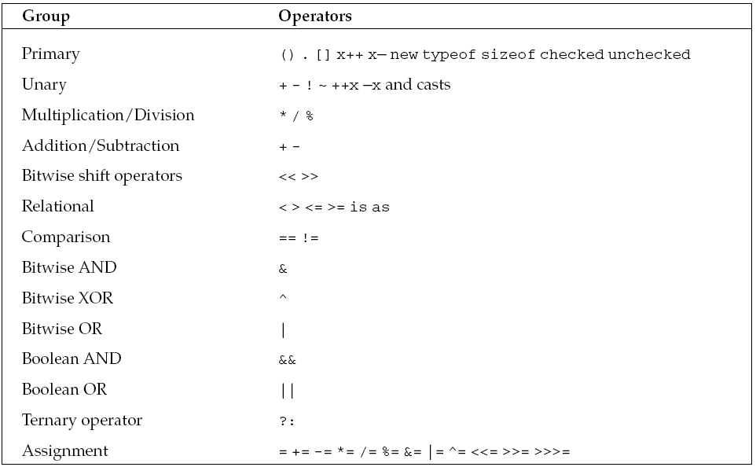
Operator Precedence

Slide 11
Type Conversions
Implicit
Explicit

Slide 12
Implicit conversions
Conversion between types can normally be achieved automatically (implicitly) only if we can guarantee that the value is not changed in any way.
we can only perform implicit conversions from a smaller integer type to a larger one, not from larger to smaller.

Slide 13
Explicit conversions
There are many conversions that cannot be implicitly made between types and the compiler will give an error if any are attempted.
These are some of the conversions that cannot be made implicitly:
int to short—May lose data
int to uint—May lose data
uint to int—May lose data
float to int—Will lose everything after the decimal point
Any numeric type to char—Will lose data
decimal to any numeric type—Since the decimal type is internally structured differently from both integers and floating-point numbers.
However, we can explicitly carry out such conversions using casts.
When we cast one type to another, we deliberately force the compiler to make the conversion. A cast looks like this:
long val = 30000;
int i = (int)val; // A valid cast. The maximum int is 2147483647

Slide 14
long val = 3000000000;
int i = (int)val; // An invalid cast. The maximum int is 2147483647
If you run the code above and output the value stored in i, this is what you get:
-1294967296
Use
int i = checked ((int)val);

Slide 15
If we need to convert between numeric and string, there are methods provided in the .NET class library.
The Object class implements a ToString() method, which has been overridden in all the .NET predefined types and which returns a string representation of the object:
int i = 10;
string s = i.ToString();
Similarly, if we need to parse a string to retrieve a numeric or Boolean value, we can use the Parse() method supported by all the predefined value types:
string s = “100”;
int i = int.Parse(s);
Console.WriteLine(i + 50); // Add 50 to prove it is really an int
Note that Parse() will register an error by throwing an exception if it is unable to convert the string (for example, if you try to convert the string Hello to an integer).

Slide 16
Boxing and Unboxing
Boxing and its counterpart, unboxing, allow us to convert value types to reference types and then back to value types.
Boxing is the term used to describe the transformation of a value type to a reference type.
E.g.
int i = 20;
object o = i;

Slide 17
Unboxing is the term used to describe the reverse process, where the value of a previously boxed value type is cast back to a value type.
We use the term cast here, as this has to be done explicitly.
The syntax is similar to explicit type conversions already described:
int i = 20;
object o = i; // Box the int
int j = (int)o; // Unbox it back into an int

Slide 18
Comparing Reference Types for Equality
ReferenceEquals()is a static method that tests whether two references refer to the same instance of a class: specifically whether the two references contain the same address in memory.
As a static method, it is not possible to override.
ReferenceEquals() will always return true if supplied with two references that refer to the same object instance, and false otherwise.
It does, however, consider null to be equal to null:
SomeClass x, y;
x = new SomeClass();
y = new SomeClass();
bool B1 = ReferenceEquals(null, null); // returns true
bool B2 = ReferenceEquals(null,x); // returns false
bool B3 = ReferenceEquals(x, y); // returns false because x and y
// point to different objects
Example: cast1.cs

Slide 19
The virtual Equals() Method
The System.Object implementation of the virtual version of Equals() also works by comparing references.
However, because this method is virtual, you can override it in your own classes in order to compare objects by value. Example : equals.cs
Syntax:
public virtual bool Equals( object obj );
obj is object to compare with the current Object.
Return Value is true if the specified Object is equal to the current Object; otherwise, false.
Example: equals1.cs

Slide 20
The static Equals() Method
The static version of Equals() actually does the same thing as the virtual instance version.
The difference is that the static version takes two parameters and compares them for equality.
This method is able to cope when either of the objects is null, and therefore, provides an extra safeguard against throwing exceptions if there is a risk that an object might be null.
The static overload first checks whether the references it has been passed are null.
If they are both null, then it returns true (since null is considered to be equal to null).
If just one of them is null, then it returns false.
If both references actually refer to something, then it calls the virtual instance version of Equals().

Slide 21
Comparison Operator (==)
The comparison operator can be best seen as an intermediate option between strict value comparison and strict reference comparison.
In most cases, writing:
bool b = (x == y); // x, y object references
means that you are comparing references

Slide 22
Comparing Value Types for Equality
Equals() is intended for value comparisons, and the comparison operator is viewed as an intermediate case.
However the big difference is that value types need to be boxed in order to convert them to references so that methods can be executed on them.

Slide 23
Operator Overloading
Operators are defined for the built-in types, but that's not all.
You can add operators to your own types, allowing them to be used much like the operators with the built-in C# types. E.g.
Matrix result = mat1.Add(mat2); // instance or
Matrix result = Matrix.Add(mat1, mat2); // static
Matrix result = mat1 + mat2; or
Matrix result = mat1 * mat2;

Slide 24
When Not to Use Operator Overloading
The idea is this: Use operators where they lend understanding and simplicity to a type. Otherwise, do not use them.

Slide 25
Implementing an Overloaded Operator
The syntax required to implement an overloaded operator is much the same as a static method with a couple exceptions.
You must use the operator keyword and specify the operator symbol being overloaded.
Here's a skeleton example of how the dot product operator could be implemented:
public static Matrix operator *(Matrix mat1, Matrix mat2)
{
// dot product implementation
}
Notice that the method is static.
Use the keyword operator after specifying the return type, Matrix in this case.
Following the operator keyword, the actual operator symbol is specified and then there is a set of parameters to be operated on.
Example : complex.cs

Slide 26
Operator Rules
C# enforces certain rules when you overload operators.
One rule is that you must implement the operator overload in the type that will use it.
This is sensible because it makes the type self-contained.
Another rule is that you must implement matching operators.
For example, if you overload ==, you must also implement !=. The same goes for <= and >=.
When you implement an operator, its compound operator works also.
For example, since the + operator for the Matrix type was implemented, you can also use the += operator on Matrix types.

Slide 27
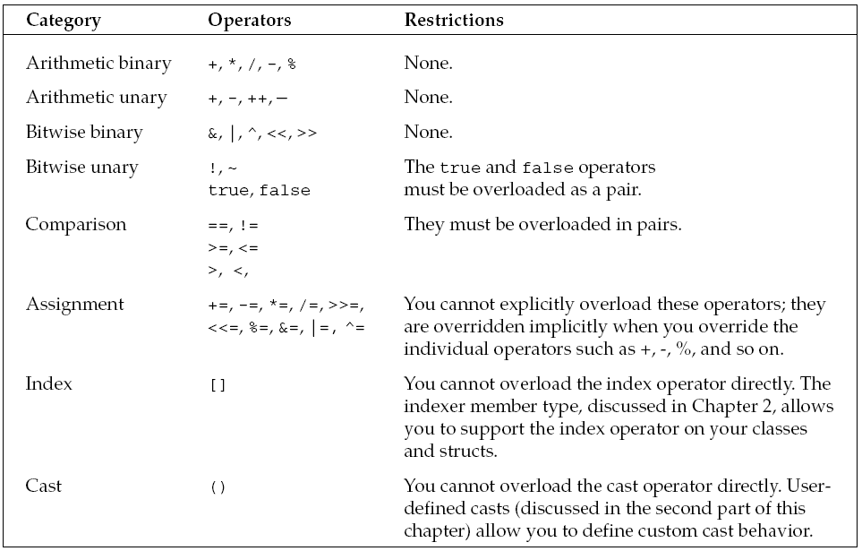
Operators that can be overloaded

Slide 28
User Defined Cast
Since C# allows you to define your own data types (structs and classes), it follows that you will need the facility to support casts to and from your data types.
The expectation is that you follow the same guidelines as for the predefined casts:
if you know the cast is always safe whatever the value held by the source variable, then you define it as implicit.
If on the other hand you know there is a risk of something going wrong for certain values—perhaps some loss of data or an exception being thrown—then you should define the cast as explicit.

Slide 29
public static implicit operator float (Currency value)
{
// processing
}

Slide 30
The return type of the operator defines the target type of the cast operation, and the single parameter is the source object for the conversion.
The cast defined here allows us to implicitly convert the value of a Currency into a float.
Note that if a conversion has been declared as implicit, then the compiler will permit its use either implicitly or explicitly.
If it had been declared as explicit, the compiler will only permit it to be used explicitly.
In common with other operator overloads, casts must be declared as both public and static.
Example: cast2.cs

Slide 31
Casts between classes
It is perfectly legitimate to define casts to convert between instances of different structs or classes that you have defined.
There are a couple of restrictions to be aware of, however.
These are:
You cannot define a cast if one of the classes is derived from the other (these types of cast already exist, as we will see).
The cast must be defined inside the definition of either the source or destination data type.
Example: usercast.cs
To illustrate these requirements, suppose you have the class hierarchy shown in Figure-

Slide 32
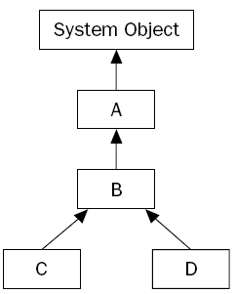

Slide 33
classes C and D are indirectly derived from A.
In this case, the only legitimate userdefined cast between A, B, C, or D would be to convert between classes C and D, because these classes are not derived from each other.
The code to do so might look like this (assuming you want the casts to be explicit, which is usually the case when defining casts between user-defined casts):
public static explicit operator D(C value)
{
// and so on
}
public static explicit operator C(D value)
{
// and so on
}

Slide 34
For each of these casts, you have a choice of where you place the definitions — inside the class definition of C, or inside the class definition of D, but not anywhere else.
C# requires you to put the definition of a cast inside either the source class (or struct) or the destination class (or struct).
A side effect of this is that you can’t define a cast between two classes unless you have access to edit the source code for at least one of them.
This is sensible because it prevents third parties from introducing casts into your classes.
Once you have defined a cast inside one of the classes, you also can’t define the same cast inside the other class.
Obviously, there should only be one cast for each conversion—otherwise the compiler wouldn’t know which one to pick.

Slide 35
Casts between base and derived classes
To see how these casts work, let’s start by considering the case where the source and destination are both reference types, and consider two classes, MyBase and MyDerived, where MyDerived is derived directly or indirectly from MyBase.
Firstly from MyDerived to MyBase; it is always possible (assuming the constructors are available) to write:
MyDerived derivedObject = new MyDerived();
MyBase baseCopy = derivedObject;

Slide 36
In this case, we are casting implicitly from MyDerived to MyBase.
This works because of the rule that any reference to a type MyBase is allowed to refer to objects of class MyBase or to objects of anything derived from MyBase.
In OO programming, instances of a derived class are, in a real sense, instances of the base class, plus something extra.
All the functions and fields defined on the base class are defined in the derived class too.

Slide 37
Alternatively, we can also write:
MyBase derivedObject = new MyDerived();
MyBase baseObject = new MyBase();
MyDerived derivedCopy1 = (MyDerived) derivedObject;
// OK
MyDerived derivedCopy2 = (MyDerived) baseObject;
// Throws exception
This code is perfectly legal C# (in a syntactic sense, that is)
However, the final statement will throw an exception when executed.

Slide 38
What happens when we perform the cast is that the object being referred to is examined.
Since a base class reference can in principle refer to a derived class instance, it is possible that this object is actually an instance of the derived class that we are attempting to cast to.
If that’s the case, then the cast succeeds, and the derived reference is set to refer to the object.
If, however, the object in question is not an instance of the derived class (or of any class derived from it) then the cast fails and an exception is thrown.

Slide 39
Notice the casts that the compiler has supplied, which convert between base and derived class do not actually do any data conversion on the object in question.
All they do is set the new reference to refer to the object if it is legal for that conversion to occur.
To that extent, these casts are very different in nature from the ones that you will normally define yourself.

Slide 40
If you actually want to convert a MyBase instance into a real MyDerived object with values based on the contents of the MyBase instance, you would not be able to use the cast syntax to do this.
The most sensible option is usually to define a derived class constructor that takes a base class instance as a parameter, and have this constructor perform the relevant initializations:
class DerivedClass : BaseClass
{
public DerivedClass(BaseClass rhs)
{
// initialize object from the Base instance
}
// etc.
}

Slide 41
Boxing and Unboxing
class TestBoxing
{
static void Main()
{
int i = 123;
object o = i; // Implicit boxing
i = 456; // Change the contents of i
System.Console.WriteLine("The value-type value = {0}", i);
System.Console.WriteLine("The object-type value = {0}", o);
}
}
/* Output:
The value-type value = 456
The object-type value = 123
*/

Slide 42
This example converts an integer variable i to an object o by using boxing.
Then, the value stored in the variable i is changed from 123 to 456.
The example shows that the original value type and the boxed object use separate memory locations, and therefore can store different values.

Slide 43
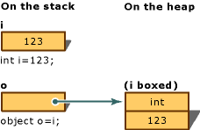
Boxing Conversion

Slide 44
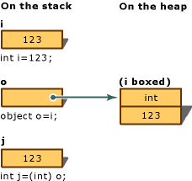
Unboxing Conversion

